Slide 1
Chapter 8: Deadlocks
We follow → Silberschatz Book
Deadlock Basic Concept
Deadlock Handling Methods
  Deadlock Prevention
  Deadlock Avoidance
  Deadlock Detection
  Deadlock Recovery

Slide 2

The Deadlock Problem
A set of blocked processes each holding a resource and waiting to acquire a resource held by another process in the set.
Example
  System has 2 tape drives.
  P₁ and P₂ each hold one tape drive and each needs another one.
Example
  semaphores A and B, initialized to 1
        P₀ P₁
        wait (A); wait(B)
        wait (B); wait(A)

Slide 3

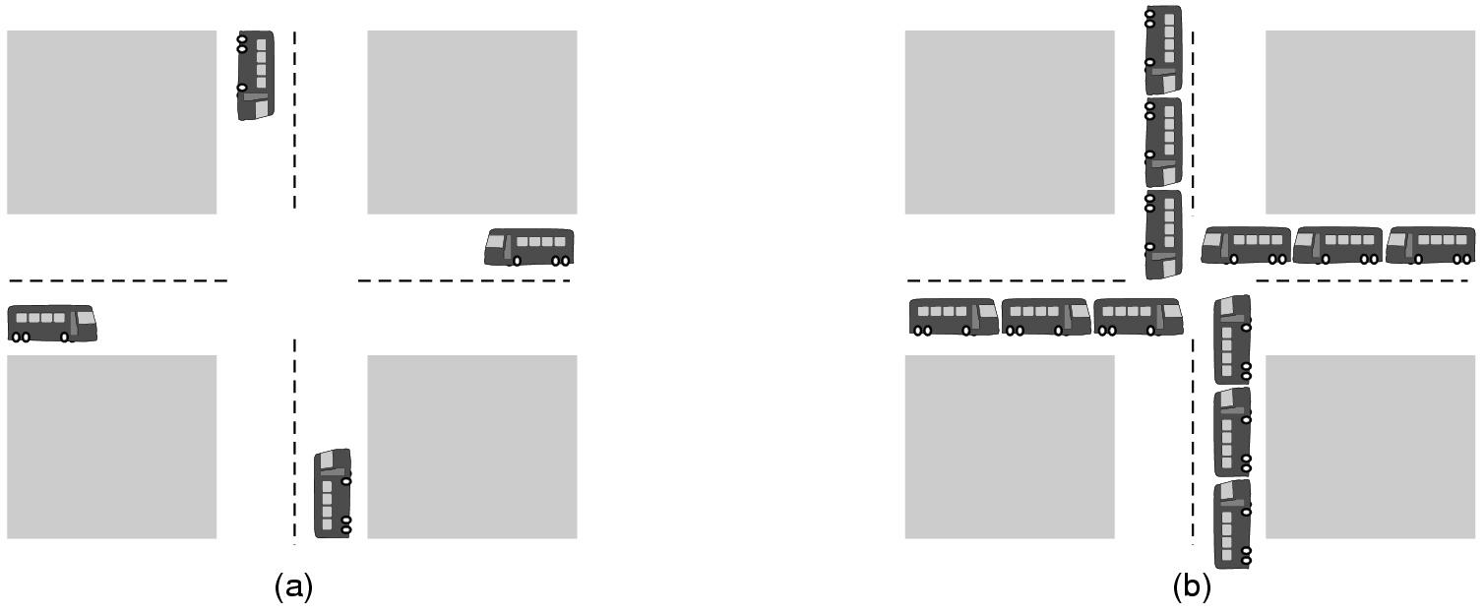
Traffic Deadlock Example

Slide 4
Bridge Crossing Example
Traffic only in one direction.
Each section of a bridge can be viewed as a resource.
If a deadlock occurs, it can be resolved if one car backs up (preempt resources and rollback).
Several cars may have to be backed up if a deadlock occurs.
Starvation is possible.

Slide 5
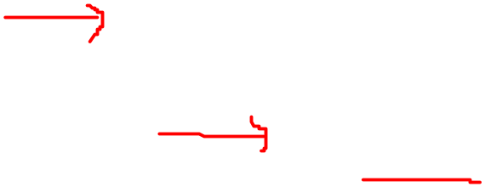
System Model
System consists of resources
Resource types R₁, R₂, . . ., R_{m}
    CPU cycles, memory space, I/O devices
Each resource type R_{i} has W_{i} instances.
Each process utilizes a resource as follows:
  request
  use
  release

Slide 6
Resource Allocation Graph
Process A
waiting for
owned by
Resource X
Resource Y
Process B
Held/owned by
waiting for

Slide 7
Deadlock Characterization
Deadlock can arise if these four conditions hold simultaneously.
Mutual exclusion: only one process at a time can use a resource.
Hold and wait: a process holding at least one resource is waiting to acquire additional resources held by other processes.
No preemption: a resource can be released only voluntarily by the process holding it, after that process has completed its task.
Circular wait: there exists a set {P₀, P₁, …, P_{n}} of waiting processes such that P₀ is waiting for a resource that is held by P₁, P₁ is waiting for a resource that is held by
P₂, …, P_{n–1} is waiting for a resource that is held by
P_{n}, and P_{n} is waiting for a resource that is held by P₀.

Slide 8
“No Preemption” in Deadlock Prevention
Context: Refers to shared resources like locks or semaphores that a process has acquired.
Principle: Once a process holds a resource, it cannot be forcibly taken away to prevent circular waiting.
Example: If Process-A holds Lock X, it shouldn't be forcefully taken away to break a potential deadlock.

Slide 9
“No Preemption” in Deadlock Prevention
The concept of "No Preemption" in the context of deadlock refers specifically to resources that have been acquired by a process and are not forcibly taken away from it to resolve a circular wait condition.
It's more related to resources like locks, semaphores, or other shared resources that a process explicitly acquires during its execution.

Slide 10
Preemption in Priority Scheduling:
Context: Refers to CPU time given to processes based on priority levels.
Principle: Higher-priority processes can preempt lower-priority ones to utilize CPU time more efficiently.
Example: If a High-priority Process-H arrives, it can preempt a Low-priority Process-L (via the OS) and use the CPU.

Slide 11
Summary
In essence, "No Preemption" in deadlock prevention is about shared resources, while preemption in priority scheduling is about CPU time allocation based on priority.
They have different contexts, and the term "preemption" is used with different meanings in these scenarios.

Slide 12
Resource-Allocation Graph
A set of vertices V and a set of edges E.
V is partitioned into two types:
  P = {P₁, P₂, …, P_{n}}, the set consisting of all the processes in the system.
  R = {R₁, R₂, …, R_{m}}, the set consisting of all resource types in the system.
request edge – directed edge P₁ → R_{j}
assignment edge – directed edge R_{j} → P_{i}

Slide 13
Resource-Allocation Graph (Cont.)
Process
Resource Type with 4 instances
P_{i} requests instance of R_{j}
P_{i} is holding an instance of R_{j}
P_{i}
R_{j}
P_{i}
R_{j}

Slide 14

Example of a Resource Allocation Graph

Slide 15

Resource Allocation Graph With A Deadlock

Slide 16

Resource Allocation Graph With A Cycle But No Deadlock

Slide 17
Basic Facts
If graph contains no cycles ⇒ no deadlock.
If graph contains a cycle ⇒
  if only one instance per resource type, then deadlock.
  if several instances per resource type exist, possibility of deadlock.

Slide 18
Methods for Handling Deadlocks
Ensure that the system will never enter a deadlock state.
  refer to Prevention Strategies
  -ve: poor resource utilization
Avoidance Method : Bankers Algorithm
Detection / Recovery Strategies: Allow the system to enter a deadlock state and then recover.
Ignorance: Ignore the problem and pretend that deadlocks never occur in the system; used by most operating systems, including UNIX.

Slide 19
Deadlock Prevention Techniques
When encountering a deadlock
  All four conditions must be true
To prevent deadlocks
  Remove one of the four conditions

Slide 20
Deadlock Prevention
Restrain the ways request can be made.
Mutual Exclusion – not required for sharable resources; must hold for nonsharable resources.
Hold and Wait – must guarantee that whenever a process requests a resource, it does not hold any other resources.
  Require process to request and be allocated all its resources before it begins execution, or allow process to request resources only when the process has none.
  Low resource utilization; starvation possible.

Slide 21
Deadlock Prevention (Cont.)
No Preemption – deny this condition
  If a process that is holding some resources requests another resource that cannot be immediately allocated to it, then all resources currently being held are released.
  Preempted resources are added to the list of resources for which the process is waiting.
  Process will be restarted only when it can regain its old resources, as well as the new ones that it is requesting.
Circular Wait – deny this condition
impose a total ordering of all resource types, and require that each process requests resources in an increasing order of enumeration.

Slide 22
Deadlock Avoidance
Requires that the system has some additional a priori information
available.
Simplest and most useful model requires that each process declare the maximum number of resources of each type that it may need.
The deadlock-avoidance algorithm (Bankers Algorithm) dynamically examines the resource-allocation state to ensure that there can never be a circular-wait condition.
Resource-Allocation State is defined by the number of available and allocated resources, and the maximum demands of the processes.

Slide 23
Avoidance Algorithms
Single instance of a resource type
  Use a resource-allocation graph (RAG)
Multiple instances of a resource type
  Use the Banker’s Algorithm
Operating System Concepts

Slide 24
Safe State
When a process requests an available resource, system must decide if immediate allocation leaves the system in a Safe State.
System is in Safe State if there exists a Safe Sequence of all processes.
Sequence <P₁, P₂, …, P_{n}> is safe if for each P_{i}, the resources that Pi can still request can be satisfied by currently available resources + resources held by all the P_{j}, with j<i.
  If P_{i} resource needs are not immediately available, then P_{i} can wait until all P_{j} have finished.
  When P_{j} is finished, P_{i} can obtain needed resources, execute, return allocated resources, and terminate.
  When P_{i} terminates, P_{i+1} can obtain its needed resources, and so on.

Slide 25
Basic Facts
If a system is in Safe State ⇒ no deadlocks.
If a system is in Unsafe State ⇒ possibility of deadlock.
Avoidance ⇒ ensure that a system will never enter an unsafe state.

Slide 26

Safe, Unsafe , Deadlock State

Slide 27
Banker’s Algorithm
The idea of Banker’s algorithm:
  Allows the sum of requested resources < total available resources
  As long as, there is some way for all processes/threads to finish without getting into any deadlocks

Slide 28
Banker’s Algorithm
Banker’s algorithm:
  A process claims its maximum resource needs in advance
  The OS allocates resource dynamically as needed. A process waits if granting its request would lead to deadlocks
  A request can be granted if some sequential ordering of processes(Safe Sequence) is deadlock free
  The OS determines the ‘Safe Sequence’

Slide 29
Example 1
Total RAM 256 MB
 | Allocated | Still needed
P₁ | 80 MB | 30 MB
P₂ | 10 MB | 10 MB
P₃ | 120 MB | 80 MB
free RAM
(MB)
46
time

Slide 30
Example 1
Total RAM 256 MB
 | Allocated | Still needed
P₁ | 80 MB | 30 MB
P₂ | 20 MB | 0 MB
P₃ | 120 MB | 80 MB
free RAM
(MB)
46
36
P₂
time

Slide 31
Example 1
Total RAM 256 MB
 | Allocated | Still needed
P₁ | 80 MB | 30 MB
P₂ | 0 MB | 0 MB
P₃ | 120 MB | 80 MB
free RAM
(MB)
46
56
36
P₂
time

Slide 32
Example 1
Total RAM 256 MB
 | Allocated | Still needed
P₁ | 110 MB | 0 MB
P₂ | 0 MB | 0 MB
P₃ | 120 MB | 80 MB
free RAM
(MB)
46
56
36
26
P₂
P₁
time

Slide 33
Example 1
Total RAM 256 MB
 | Allocated | Still needed
P₁ | 0 MB | 0 MB
P₂ | 0 MB | 0 MB
P₃ | 120 MB | 80 MB
free RAM
(MB)
136
46
56
36
26
P₂
P₁
time

Slide 34
Example 1
Total RAM 256 MB
 | Allocated | Still needed
P₁ | 0 MB | 0 MB
P₂ | 0 MB | 0 MB
P₃ | 200 MB | 0 MB
free RAM
(MB)
136
46
56
56
36
26
P₂
P₁
P₃
time

Slide 35
Example 1
Total RAM 256 MB
 | Allocated | Still needed
P₁ | 0 MB | 0 MB
P₂ | 0 MB | 0 MB
P₃ | 0 MB | 0 MB
256
free RAM
(MB)
136
46
56
56
36
26
P₂
P₁
P₃
time

Slide 36
Example 1
Total RAM 256 MB
 | Allocated | Still needed
P₁ | 80 MB | 30 MB
P₂ | 10 MB | 10 MB
P₃ | 120 MB | 80 MB
256
free RAM
(MB)
136
The system is initially in
a safe state, since we can
run P₂, P₁, and then P₃
46
56
56
36
26
P₂
P₁
P₃
time

Slide 37
Example 2
Total RAM 256 MB
 | Allocated | Still needed
P₁ | 80 MB | 60 MB
P₂ | 10 MB | 10 MB
P₃ | 120 MB | 80 MB
free RAM
(MB)
46
time

Slide 38
Example 2
Total RAM 256 MB
 | Allocated | Still needed
P₁ | 80 MB | 60 MB
P₂ | 20 MB | 0 MB
P₃ | 120 MB | 80 MB
free RAM
(MB)
46
36
P₂
time

Slide 39
Example 2
Total RAM 256 MB
 | Allocated | Still needed
P₁ | 80 MB | 60 MB
P₂ | 0 MB | 0 MB
P₃ | 120 MB | 80 MB
free RAM
(MB)
46
56
36
P₂
time

Slide 40
Example 2
Total RAM 256 MB
 | Allocated | Still needed
P₁ | 80 MB | 60 MB
P₂ | 0 MB | 0 MB
P₃ | 120 MB | 80 MB
free RAM
(MB)
46
56
36
P₂
time

Slide 41
Example 2
Total RAM 256 MB
 | Allocated | Still needed
P₁ | 80 MB | 60 MB
P₂ | 10 MB | 10 MB
P₃ | 120 MB | 80 MB
free RAM
(MB)
The system is initially in an unsafe state, since we cannot find an execution sequence for P₁, P₂, and P₃
46
56
36
P₂
time

Slide 42
Banker’s Algorithm
Multiple instances of same resource type.
Each process must a priori claim maximum use.
When a process requests a resource it may have to wait.
When a process gets all its resources it must return them in a finite amount of time.

Slide 43
Example of Banker’s Algorithm
5 processes P₀ through P₄; 3 resource types A
(10 instances), B (5 instances) and C (7 instances).
Snapshot at time T₀:
Allocation Max Available [Free]
A B C A B C A B C
P₀ 0 1 0 7 5 3 3 3 2
P₁ 2 0 0 3 2 2
P₂ 3 0 2 9 0 2
P₃ 2 1 1 2 2 2
P₄ 0 0 2 4 3 3
Total Available = 10, 5, 7

Slide 44
Example (Cont.)
The content of the matrix. Need is defined to be Max – Allocation.
Need Matrix = Max – Allocation
Need
A B C
P₀ 7 4 3
P₁ 1 2 2
P₂ 6 0 0
P₃ 0 1 1
P₄ 4 3 1
The system is in a safe state since the sequence < P₁, P₃, P₄, P₂, P₀> satisfies safety criteria.

Slide 45
Example P₁ Request (1,0,2) (Cont.)
Check that Request ≤ Available (that is, (1,0,2) ≤ (3,3,2) ⇒ true.
Allocation Need Available [Free]
A B C A B C A B C
P₀ 0 1 0 7 4 3 2 3 0
P₁ 3 0 2 0 2 0
P₂ 3 0 1 6 0 0
P₃ 2 1 1 0 1 1
P₄ 0 0 2 4 3 1
Executing safety algorithm shows that sequence <P₁, P₃, P₄, P₀, P₂> satisfies safety requirement.
Can request for (3,3,0) by P₄ be granted? False
Can request for (0,2,0) by P₀ be granted? True

Slide 46
Deadlock Detection
Allow system to enter deadlock state
Apply the → Detection Algorithm
Then deploy some → Recovery Scheme

Slide 47
Single Instance of Each Resource Type
Maintain wait-for graph
  Nodes are processes.
  P_{i} → P_{j} if P_{i} is waiting for P_{j}.
Periodically invoke an algorithm that searches for a cycle in the graph.
An algorithm to detect a cycle in a graph requires an order of n² operations, where n is the number of vertices in the graph.

Slide 48

Resource-Allocation Graph and Wait-for Graph
Resource-Allocation Graph
Corresponding wait-for graph

Slide 49
Recovery from Deadlock:
Process Termination
Abort all deadlocked processes. (no labor involved)
Abort one process at a time until the deadlock cycle is eliminated.
In which order should we choose to abort?
  Priority of the process.
  How long process has computed, and how much longer to completion.
  Resources the process has used.
  Resources process needs to complete.
  How many processes will need to be terminated.
  Is process interactive or batch?

Slide 50

Recovery from Deadlock:
Resource Preemption
Selecting a victim – minimize cost.
Rollback – return to some safe state, restart process for that state.
Starvation – same process may always be picked as victim, include number of rollback in cost factor.

Slide 51

Combined Approach to Deadlock Handling
[ ***Not Included in*** ]
Combine the three basic approaches → NO
  prevention
  avoidance
  detection
allowing the use of the optimal approach for each of resources in the system.
Partition resources into hierarchically ordered classes.
Use most appropriate technique for handling deadlocks within each class.

